Slide 1
Money, Banking and International & Sustainable Finance
Lecture 2
International Banking
Prof. Dhafer SAIDANE

Slide 2
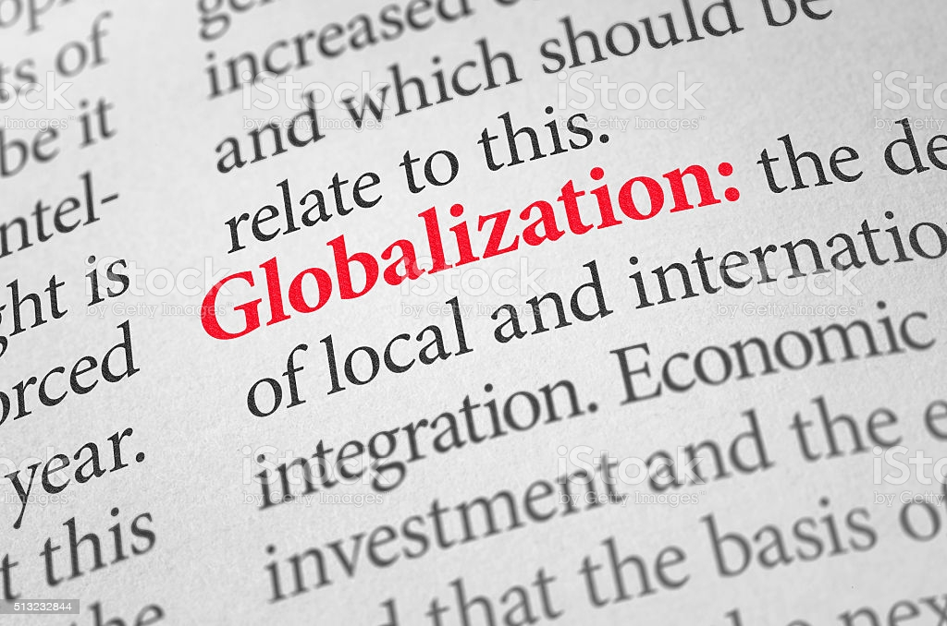
International Banking
Globalization
Process by which an organization develop international influence and operate on an international scale.
Acceleration of exchanges (of human beings, goods, and services, capital, technologies or cultural practices) all over the planet.
Increases interactions between different regions and populations around the globe.

Slide 3
International Banking
Globalization : The Exponential Push in Trade
Since 1970, there has been great growth in international trade.
Global exports increased up to 17.5 trillion USD in 2017,
The value of trade was 19.48 trillion USD in 2018, due to higher energy prices.
In 2023 the annual Trade value is nearly USD24 trillion. In 2025, Trade value USD 26 trillion.

Slide 4
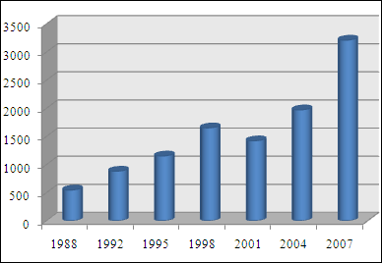
International Banking
Financial Globalization: FOREX
More impressive is the growth in foreign exchange (FOREX).
Trading in Foreign exchange markets averaged 5.0 trillion USD per day in April 2016.
Trading in the global FOREX market has jumped to 7.5 trillion USD daily volume in 2022 and 9.6 trillion USD in 2025.

Slide 5
International Banking
Financialization
Process whereby financial markets and financial institutions, gain greater influence over real economic outcomes.
As a reminder:
The global financial market is worth $23 trillion as of 2021
Global finance (Financial Market+Banks)= all credits, bonds, stocks and monetary assets = $400 trillion
The global GDP (Gross domestic product) is worth $100 trillion as of 2022

Slide 6
International Banking: Supporting major clients across the world
EX: Citigroup has over 50% of its assets (600 Billion USD) located outside the US.
Citigroup provides services to clients in over 100 countries around the world!
  General Motors has a relationship with Mexican suppliers. GM finds it convenient to have an account with Citibank in Mexico.
  Honda has a manufacturing plant outside Ohio. It might be convenient for Honda to open an account with Citigroup in the US to finance its US operations.

Slide 7
Why International Banking?
Facilitation of international transactions
Managing exchange risk
Avoiding Regulation (Eurodollars)
Avoiding Taxes (Offshore Banking)

Slide 8
Types of Banks
US Banks Abroad
  Branches
  Foreign Subsidiary
  International Banking Facility: IBF allows U.S. banks to offer deposit, loan, and other banking services to foreign residents.
Foreign Banks in the US
  Branches
  Agency Offices
  US Subsidiary

Slide 9
Eurodollars
Since WWII, the dollar has become the first international currency. Therefore, many foreign companies and governments hold dollars rather than their currency.
Further, to avoid interest rate restrictions, US banks began offering dollar accounts at their foreign branches. These accounts were known as Eurodollar accounts.
Euromarkets have expanded into Euro-bonds, Euro-loans, and Euro-Commercial paper.
There are currently over $30 Trillion in Euro deposits around the world.

Slide 10
Exchange Rate Risk
In addition to liquidity, and interest rate risks, international banks must also deal with exchange rate risk.

Slide 11
A Bank is an Intelligence Central Agency dedicated to risk management
The first role of a bank is to reduce all risks, i.e. reduce information asymmetry.
Exchange Rate Risk
Balance Sheet
Assets
Liabilities
Loans
Deposits
Risk of Default
Risk of liquidity
information asymmetry
information asymmetry
Risk of transformation
information asymmetry

Slide 12
An Example of Exchange Rate Risk scenario 1: 1€=1.25$ scenario 2: 1€=1.30$
We must first convert euros into dollars according to scenario 1 and then according to scenario 2.
Assets
Cash Reserves: $2M+€2M
Securities (lended): $15M
Loans
Consumer: $5M+ €20
Real Estate: €3M
Total: $53.25M
Liabilities
Deposits
Checking: $10M+€10M
Savings: €10M
Eurodollar Accounts: $10M
Equity (borrowed): $ ? M scenario 1
Equity (borrowed): $ ? M scenario 2
Total: $53.25M
As a banker, calculate the dollar amount you would need to borrow from the market to balance your balance sheet?

Slide 13
An Example of Exchange Rate Risk scenario 1: 1€=1.25$ scenario 2: 1€=1.30$
We must first convert euros into dollars according to scenario 1 and then according to scenario 2.
Assets
Cash Reserves: $2M+€2M
Securities (lended): $15M
Loans
Consumer: $5M+ €20
Real Estate: €3M
Total: $53.25M
Liabilities
Deposits
Checking: $10M+€10M
Savings: €10M
Eurodollar Accounts: $10M
Equity (borrowed): $8.25M scenario 1
Equity (borrowed): $8.50M scenario 2
Total: $53.25M

Slide 14
An Example
scenario 1: 1€=1.25$
Dollar Assets: $22M
Euro Assets: €25M * $1.25/€ = $31.25M
Total: $53.25M
Dollar Liabilities: $20M
Euro Liabilities: €20M * $1.25/€ = $25M
Total: $45M
Equity gap = $53.25M - $45M = $8.25M

Slide 15
Suppose that the dollar depreciates to $1.30
Dollar Assets: $22M
Euro Assets: € 25M * $1.30/E = $32.5M
Total: $54.5M
Dollar Liabilities: $20M
Euro Liabilities: € 20M * $1.30/ € = $26M
Total: $46M
Equity gap = $54.5M - $46M = $8.5M

Slide 16
The financial constellation
International Institutions
Treasury+Government
Growth=GDP
Central Bank
World Bank
IMF
WTO
Financial Services
Central Bank
Banks
Non Banks
Financial Markets
Corporate
Monetary policy
Retail Banks
Investment Banks
Insurance
Pension Funds
Money Market
Stocks Market
Bonds Market
Exchange Market
Companies
Advisory/Consulting

Slide 17
WOOCLAP
4 to 12

